Slide 1
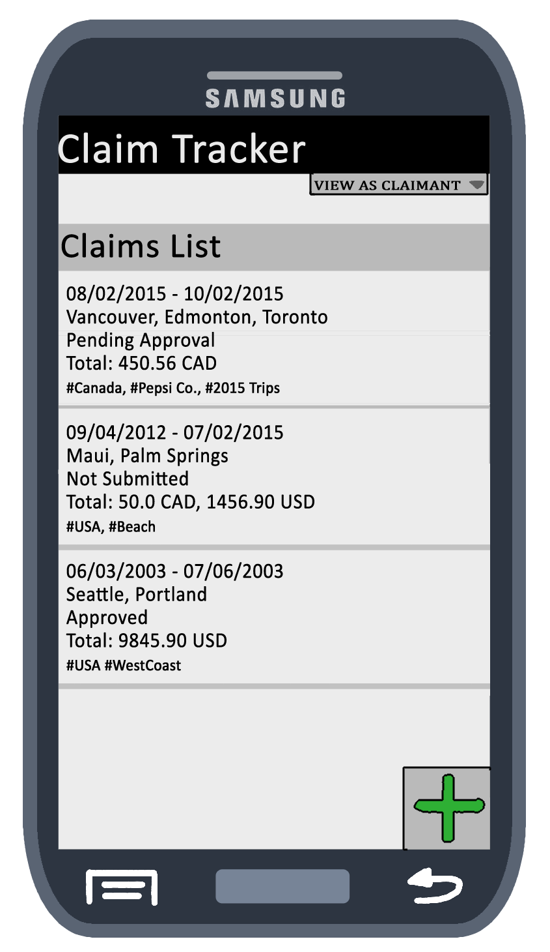
Main Screen (Claimant Mode)
Clickable claim list, add new claim button, and option to change from claimant view to approver view.
When clicked, claims display three options: view/edit, delete, and add expense.

Slide 2
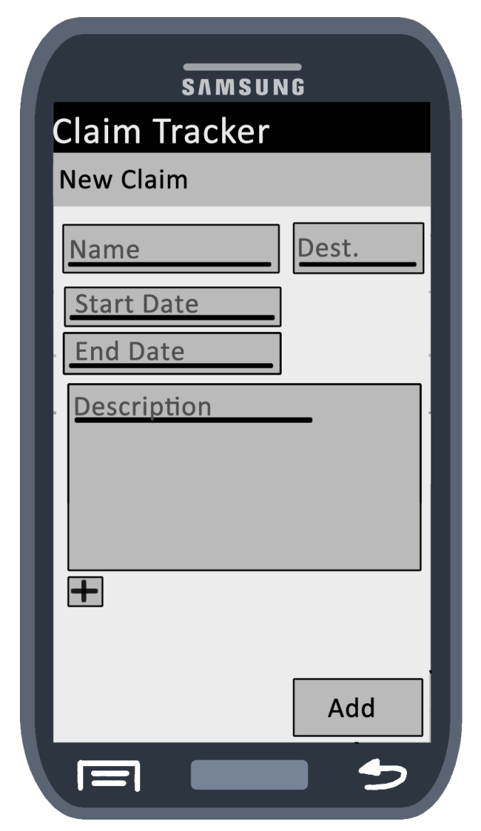
New Claim Screen

Slide 3
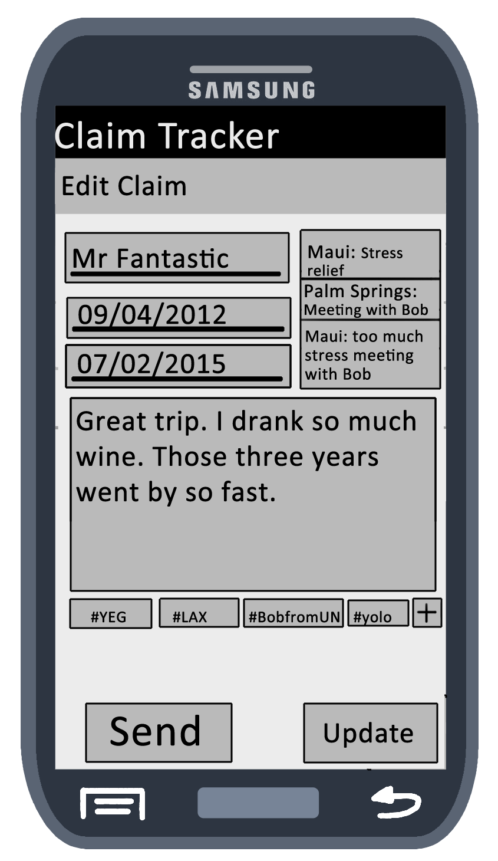
Edit Claim Screen (Left Side)
Editable text fields filled in with information, update button (returns to menu), send button.
Swipe left to view expenses.

Slide 4
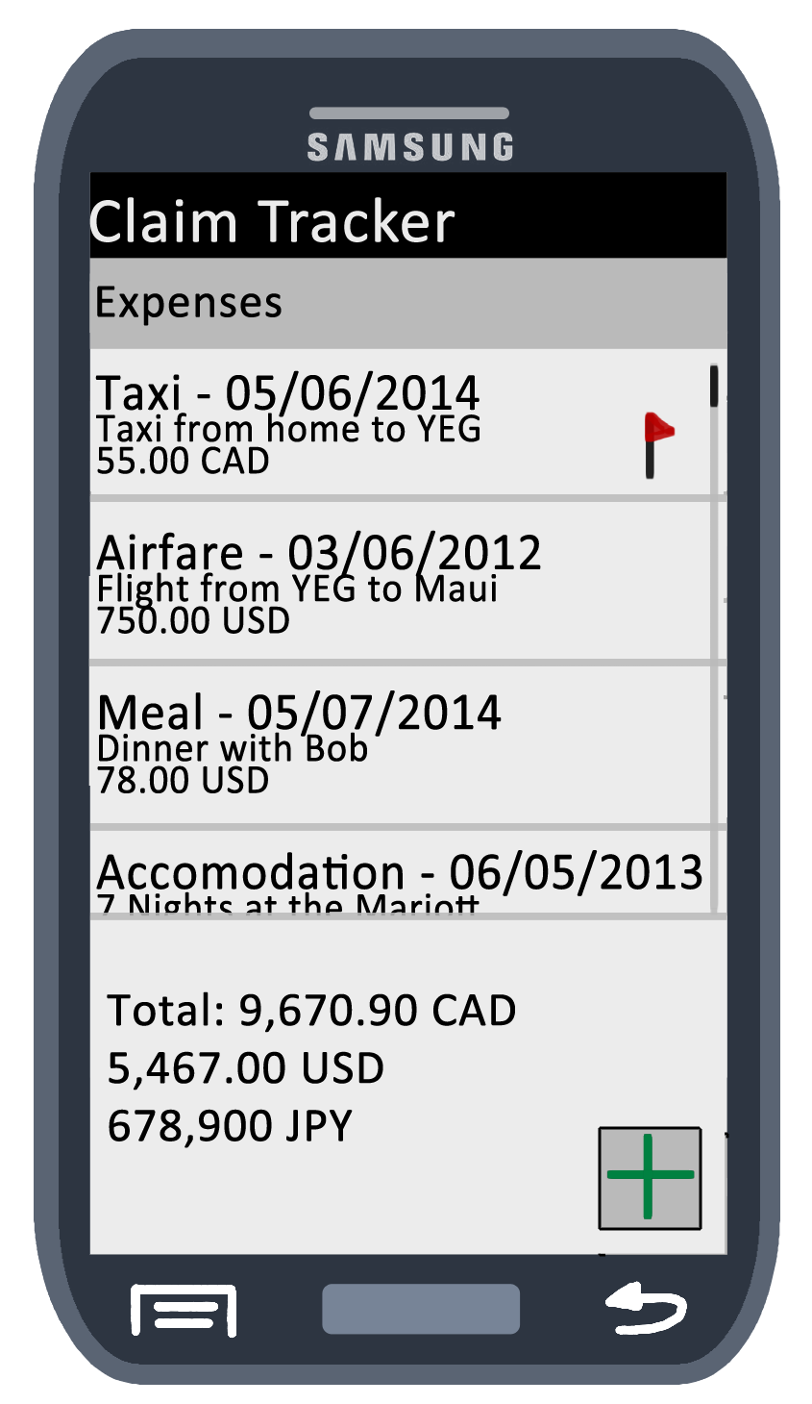
Edit Claim Screen (Right Side)
Clickable list of expenses, money totals, new expense button.
When clicked, options are available for expense: edit, delete, flag/unflag

Slide 5
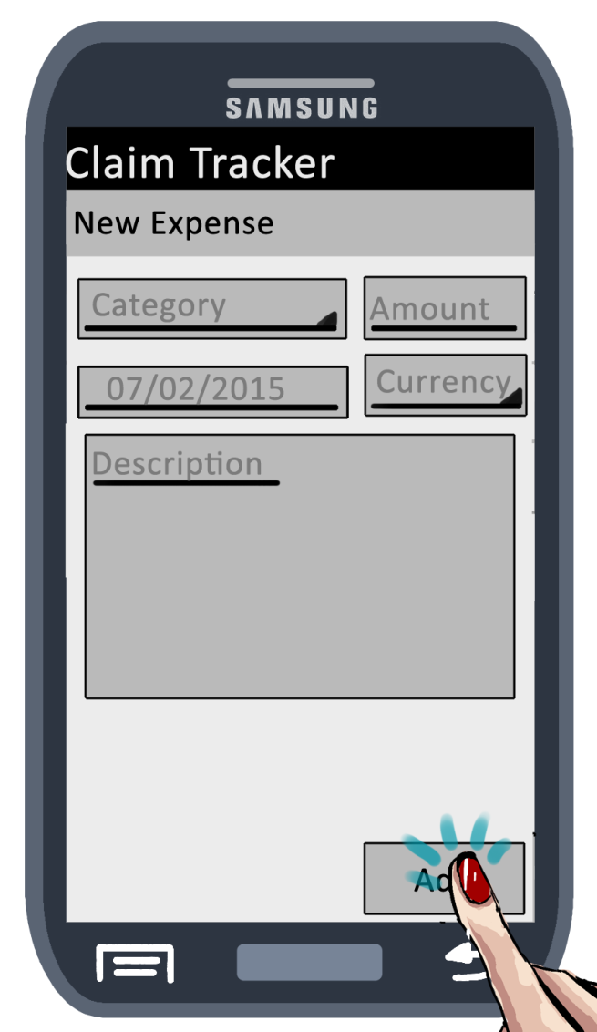
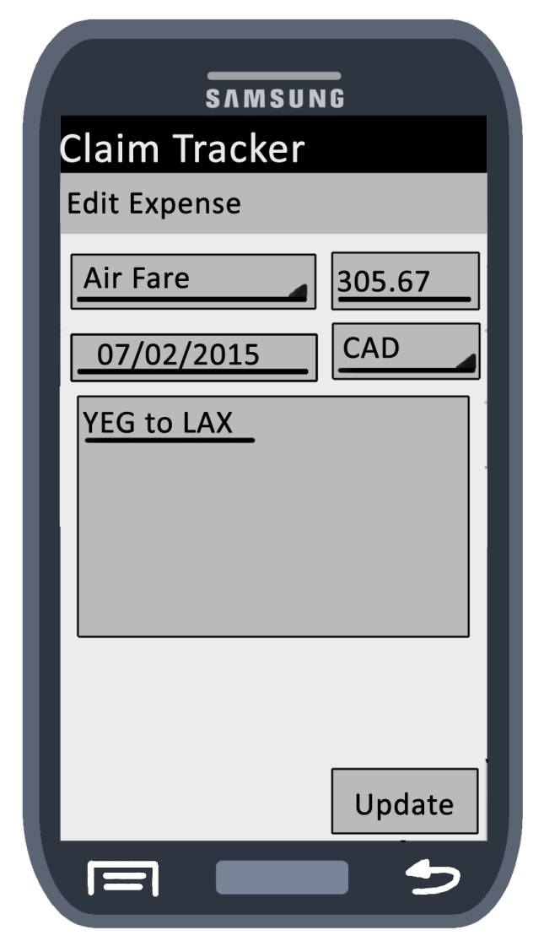
Edit/New Expense

Slide 6
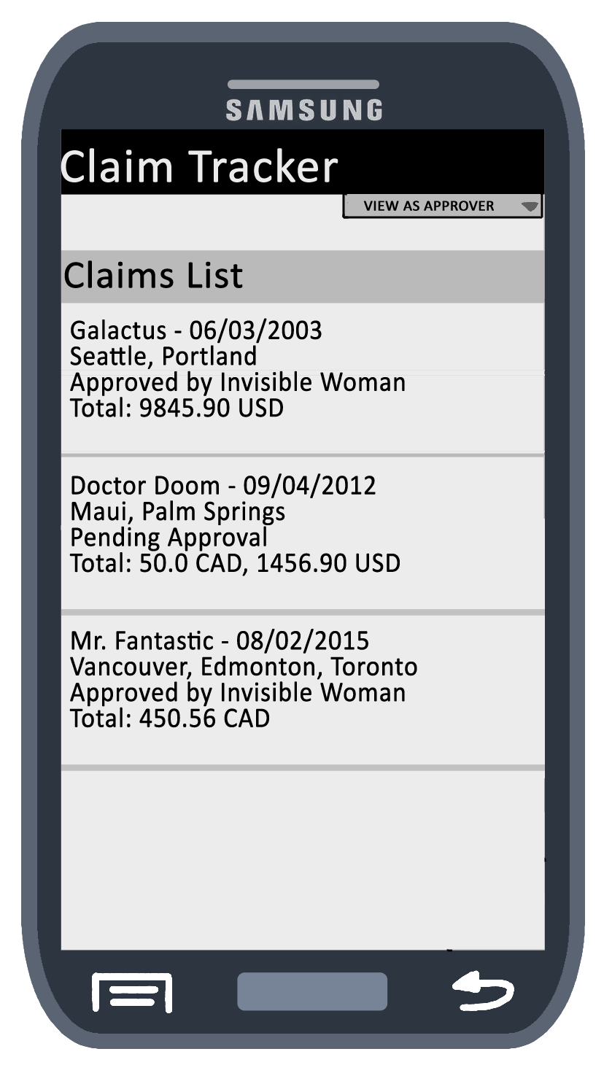
Main Screen (Approver Mode)
Clickable claims, option to change to Claimant at the top.
When clicked, approvers have options to: view, add comment, approve, return without approval

